Slide 1
Notes:
Multiple greetings from Africa

Slide 2
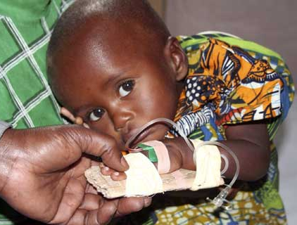
What is Malaria
Malaria Symptoms:
chills
nausea
convulsions
severe headaches
muscle pain & weakness
high fever (106ºF)
Malaria can lead to
brain damage, organ failure, coma, other infections, or
death.

Slide 3
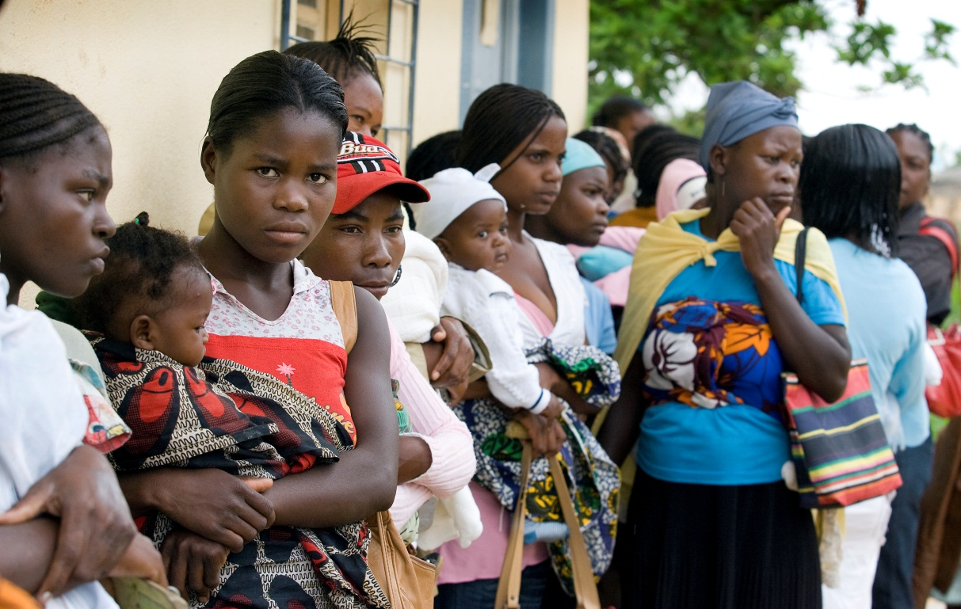
Malaria is preventable.
A disease of poverty.

Slide 4
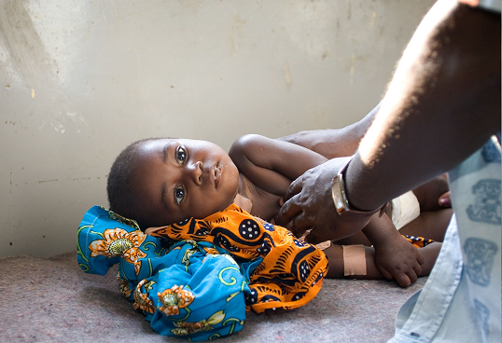
1 death every 30 seconds…
Notes:
Progress has been made.
When Nothing But Nets started in 2006 there was one death every 30 seconds

Slide 5
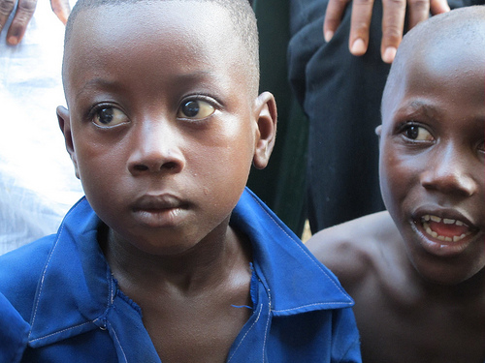
1 death every 60 seconds…

Slide 6
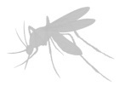
Every 60 Seconds…
. . . a child in Africa dies of malaria
2,000 children will die today
655,000 children will die this year

Slide 7
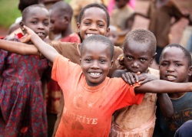
0 deaths
A world with no malaria
Notes:
Goal

Slide 8
Holston Conference’s Goal
100,000 lives saved
$1 million

Slide 9
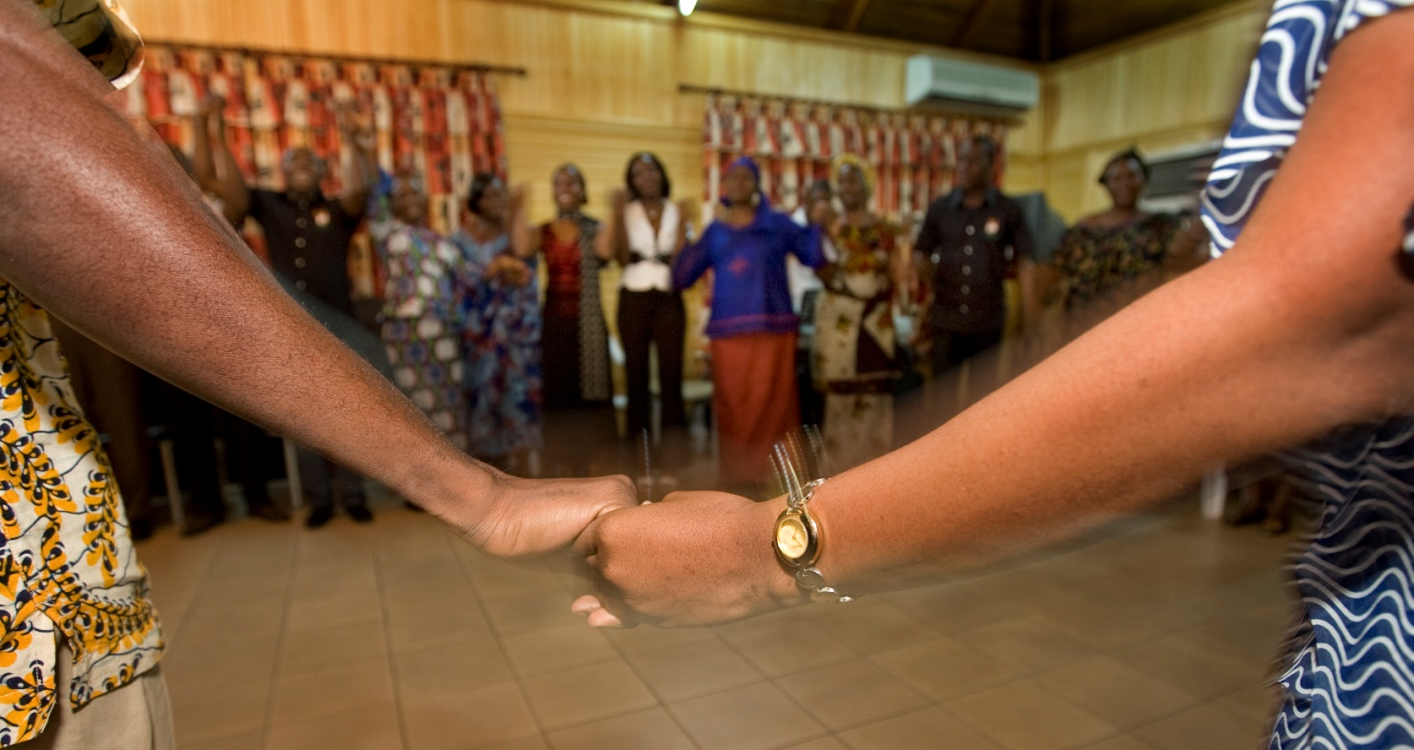
Our Faith in Action…

Slide 10
A History of Healing

Slide 11
Prevention
Nets
Access to diagnostic tests and medicine
Draining standing water
Improving sanitation

Slide 12
Treatment
Improving infrastructure
The UMC operates hundreds of churches, schools, and hospitals in Africa
Ensure facilities have the diagnostic tests and treatment needed to save lives

Slide 13
Education
“Education is the most powerful weapon which you can use to change the world.” ---Nelson Mandela
Outreach to those who need it most
Train thousands of local people in African communities to teach their communities about avoiding malaria

Slide 14
Communication
African communities do not rely on printed communications
Upgrade communication networks
Building new radio stations
Providing hand-crank and solar-powered radios

Slide 15
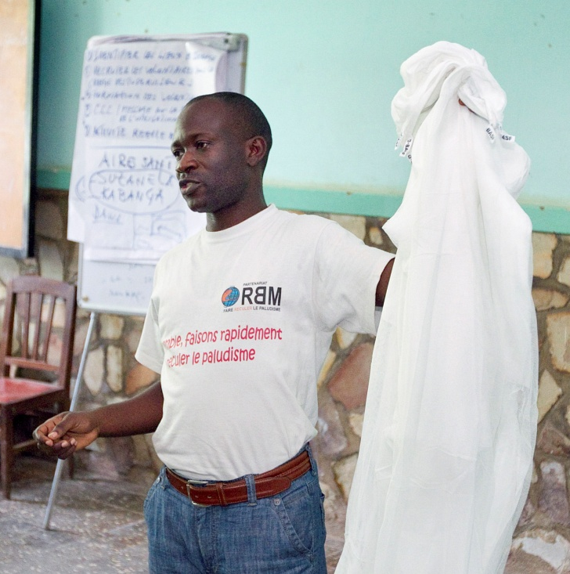
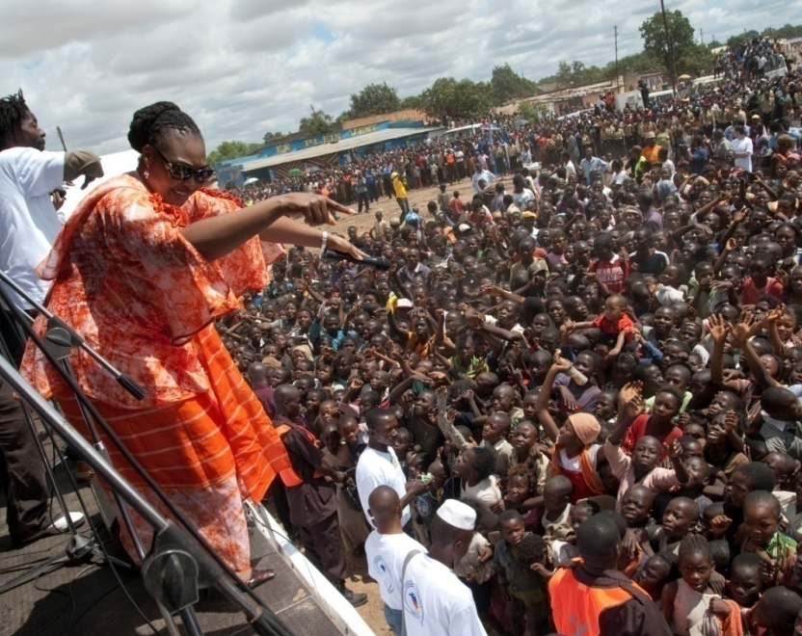
World Class Results
846,000 nets distributed
5,000 local Community Health workers trained
15 in-country health boards established and trained to oversee comprehensive programs

Slide 16
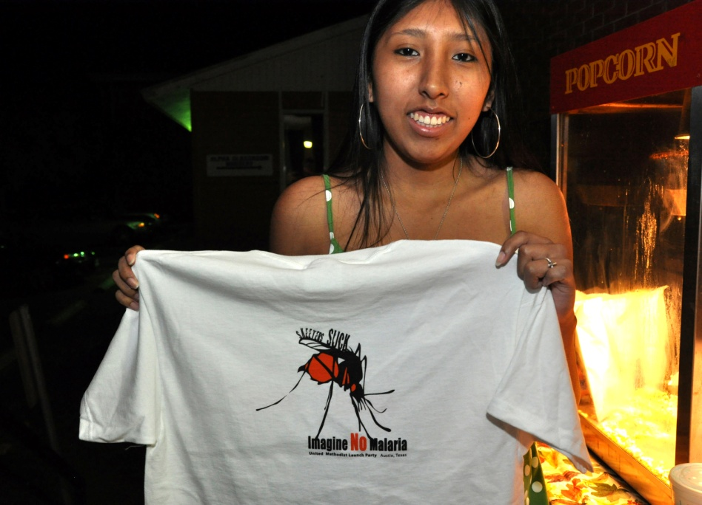
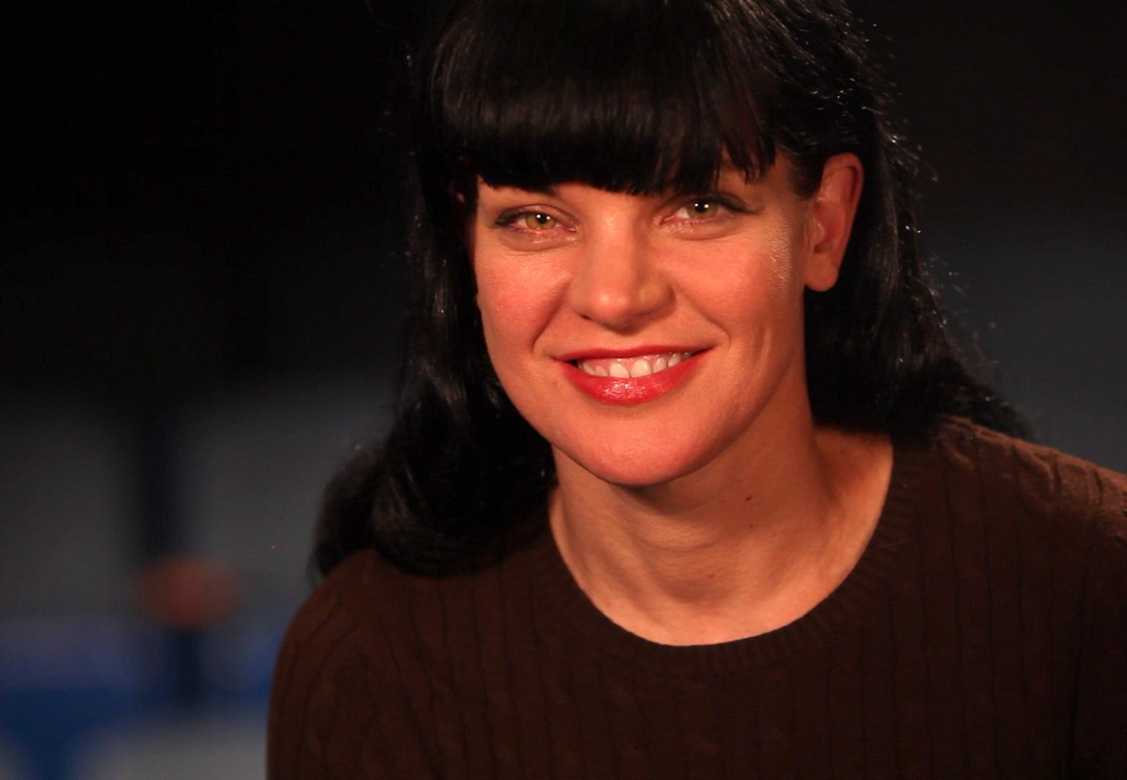
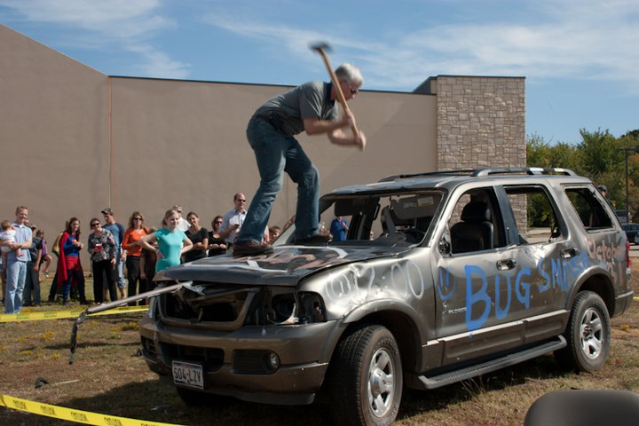
Community outreach
Imagine No Malaria = Opportunity

Slide 17
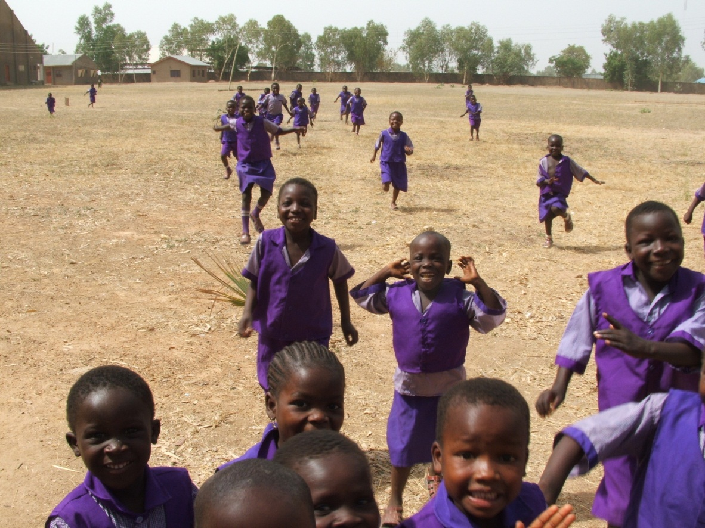
Together
we will save
MILLIONS OF LIVES!
Notes:
Together, with United Methodists across the globe, we will save millions of lives

Slide 18
Connect
Imagine No Malaria: Holston
@NoMalariaHC
leraecollins@holston.org
www.ImagineNoMalaria.org

Slide 19
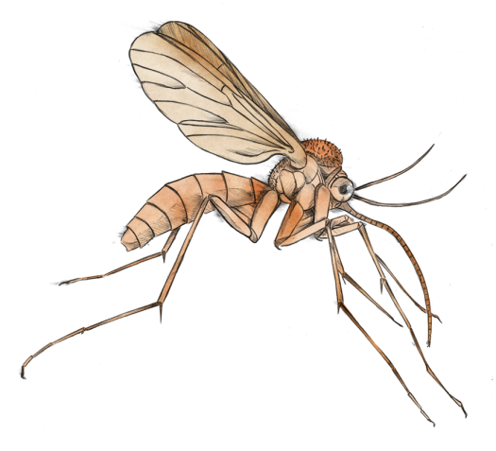
African Proverb
If you think you are too small to make a difference, try sleeping in a closed room with a mosquito.

Slide 20
Advance #684
Notes:
Give through Advance #684

